Slide 1



Slide 2



01CE0701 – Mobile Computing
Unit - 6
Wireless Application Protocol

Slide 3


Outline
Introduction of WAP
Features of WAP
WAP Architecture
WAP Protocol Stack
WAP applications
Limitations of WAP

Slide 4

Introduction of WAP

Slide 5
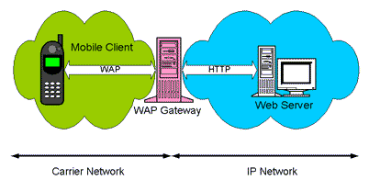
Introduction of Wireless Access Protocol
WAP is an application communication protocol
It is designed for access to Internet and advanced telephony services from mobile phones
It is a protocol designed for micro-browsers and it enables the access of internet in the mobile devices
WAP uses mark-up language – WML
WAP can be used from variety of 2G and 3G networks
GPRS and 3G are more suited for these applications

Slide 6
Features of WAP

Slide 7
Features of WAP
Wireless Markup Language (WML): You must be using HTML language to develop your web-based application. Same way, WML is a markup language used for WAP services, fulfilling the same purpose as HTML does on the Web. In contrast to HTML, WML is designed to fit small handheld devices.
WML Script: Java Script or VB script is used to enhance the functionality of your web applications. Same way, WML Script can be used to enhance the functionality of a service, just as Java script can be utilized in HTML.
Wireless Telephony Application Interface (WTAI): The WTAI is an application framework for telephony services. WTAI user agents are able to make calls and edit the phone book by calling special WML Script functions. Ex., If one writes WML script containing names of people and their phone numbers, you may add them to your phone book or call them right away just by clicking the appropriate hyperlink on the screen.

Slide 8
WAP Architecture

Slide 9
WAP Architecture
Client
Web Server
WAP Gateway
WML
WML Encoder
CGI
Scripts
etc.
WML-Script
WSP/WTP
HTTP
WML Script
Compiler
WML Decks
with WML-Script
WTAI
Protocol Adapters
Content
Etc.
CGI – Common Gateway Interface
WML – Wireless Markup Language
WTAI - Wireless telephony application interface

Slide 10
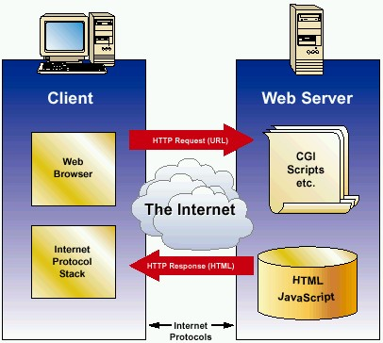
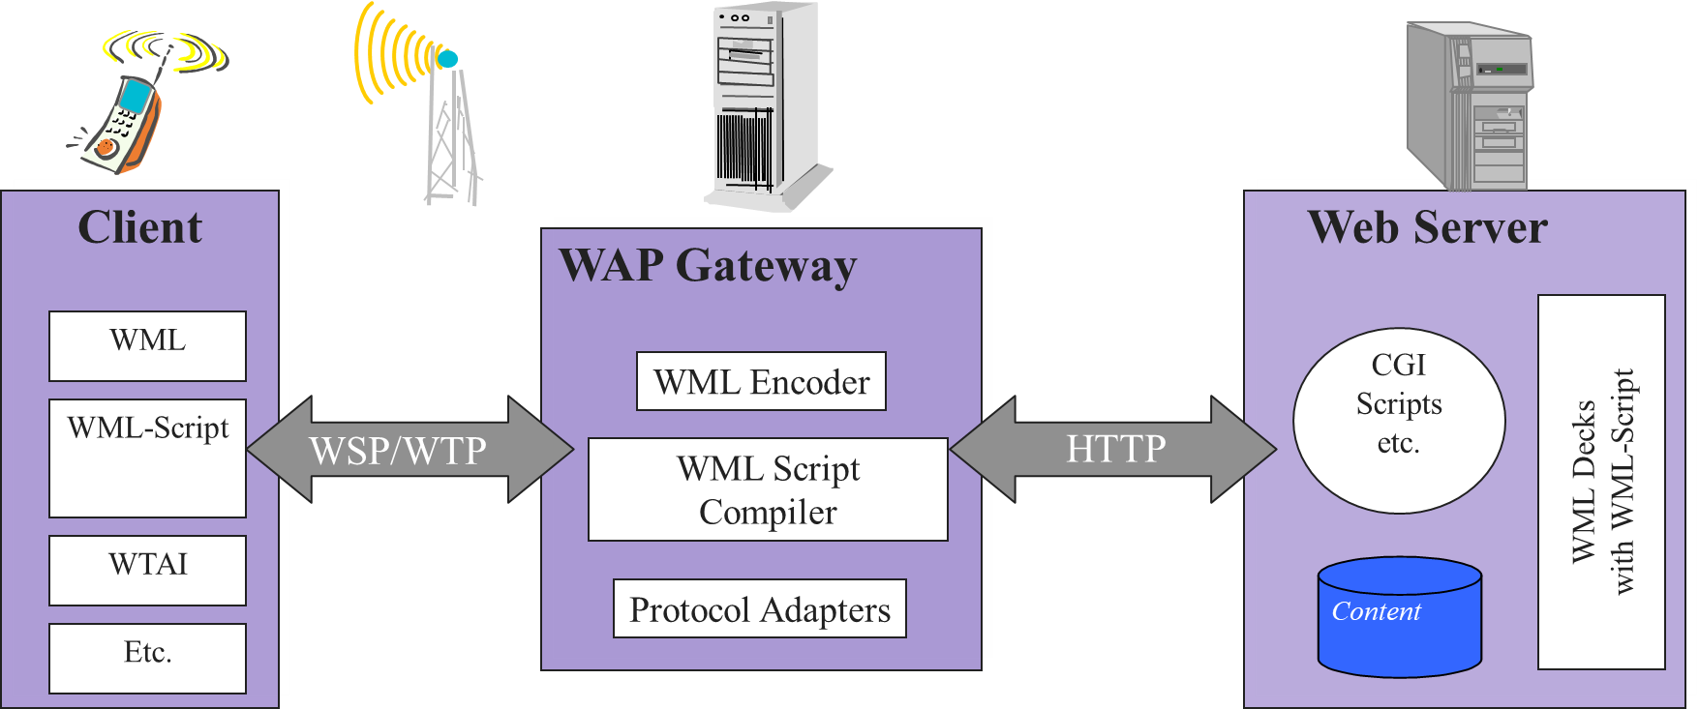
WAP Architecture (Compare with internet model)
HTML
HTTP
TLS/SSL
TCP/IP
Fig. 1 Internet Architecture
Fig. 2 WAP Architecture
Note, the similarities with the Internet model.
Without the WAP Gateway, the two models would have been practically identical.
The WAP architecture (WAP model) consists of 3 levels:
Client
Gateway
Origin Server.

Slide 11
WAP Architecture
When a user opens the browser in his/her mobile device and selects a website that he/she wants to view, the mobile device sends the URL encoded request via a network to a WAP gateway using WAP protocol.
The request he/she sends via mobile to WAP gateway is called as encoding request.
The sent encoding request is translated through WAP gateway and then forwarded in the form of a conventional HTTP URL request over the Internet.
When the request reaches a specified Web server, the server processes the request just as it would handle any other request and sends the response back to the mobile device through WAP gateway.
Now, the WML file's final response can be seen in the browser of the mobile users.

Slide 12
WAP Protocol Stack

Slide 13
WAP Protocol Stack
Application Layer (WAE)
Other Services and Applications
Session Layer (WSP)
Transaction Layer (WTP)
Security Layer (WTLS)
Transport Layer (WDP)
Bearers:
GSM
IS-136
CDMA
PHS
CDPD
PDC-P
IDEN
FLEX
etc…
Wireless Application Environment
(WAE)
Wireless Transaction Protocol
(WTP)
Wireless Session Protocol
(WSP)
Wireless Transport Layer Security
(WTLS)
Wireless Datagram Protocol
(WDP)
It runs on top of a datagram service such as User Datagram Protocol (UDP) and is part of the standard suite of TCP/IP protocols used to provide a simplified protocol suitable for low bandwidth wireless stations.
WTP supports class of transaction service, optional user-to-user reliability, PDU concatenation and asynchronous transaction.
WTLS incorporates security features that are based upon the established Transport Layer Security(TLS) protocol standard.
It provides data integrity, privacy, authentication, denial of service protection.
Primary objective of WAE is to provide an interoperable environment to build services in wireless space.
Content is transported using standard protocols in the WWW domain and an optimized HTTP like protocol in the wireless domain.
Wireless Telephony Application: Telephony services and programming interface.
WAP Push Architecture which allow for mechanisms to allow origin servers to deliver content to the terminal without the terminal requesting for it.
WAE architecture allows all content and services to be hosted on standard Web Servers when all content is located using WWW standard URLs.
WAE enhances some of the WWW standards to reflect some of the telephony network characteristics.
Unlike HTTP, WSP has been designed by the WAP Forum to provide fast connection suspension and reconnection.
WSP provides a consistent interface between two session services like client and server.
WSP offers both connection-oriented and connectionless service.
WDP is transport layer protocol in WAP architecture.
WDP operates above data capable bearer services supported by various network type general transport service.
It allows WAP to be bearer-independent by adapting the transport layer of the underlying bearer.
The WDP presents a consistent data format to the higher layers of the WAP protocol stack.
User agent which is the browser or a client program.
Wireless Markup Language (WML) which is a lightweight markup language optimized for use in wireless devices.
WML Script which is a lightweight client side scripting language.

Slide 14
Application Layer
This layer consists of the Wireless Application Environment (WAE), mobile device specifications, and content development programming languages, i.e., WML.
User agent which is the browser or a client program. Wireless Markup Language (WML) which is a lightweight markup language optimized for use in wireless devices.
WML Script which is a lightweight client side scripting language.
Wireless Telephony Application: Telephony services programming interface.
WAP Push Architecture which allow for mechanisms to allow origin servers to deliver content to the terminal without the terminal requesting for it.
Primary objective of WAE is to provide an interoperable Wireless Application Environment to build services in wireless space. Content is transported using standard protocols in the WWW domain and an optimized HTTP like protocol in the wireless domain.
WAE architecture allows all content and services to be hosted on standard Web Servers when all content is located using WWW standard URLS. WAE enhances some of the WWW standards to reflect some of the telephony network characteristics.

Slide 15
Session Layer
The session layer consists of the Wireless Session Protocol (WSP).
Unlike HTTP, WSP has been designed by the WAP Forum to provide fast connection suspension and reconnection.
WSP provides a consistent interface between two session services like client and server.
WSP offers both connection-oriented and connectionless service.

Slide 16
Transaction Layer
The transaction layer consists of Wireless Transaction Protocol (WTP).
It runs on top of a datagram service such as User Datagram Protocol (UDP) and is part of the standard suite of TCP/IP protocols used to provide a simplified protocol suitable for low bandwidth wireless stations.
WTP supports class of transaction service, optional user-to-user reliability, PDU concatenation and asynchronous transaction.

Slide 17
Security Layer
It contains Wireless Transaction Layer Security (WTLS) and responsible for data integrity, privacy and authentication during data transmission.
WTLS incorporates security features that are based upon the established Transport Layer Security (TLS) protocol standard.

Slide 18
Transport Layer
This layer consists of Wireless Datagram Protocol (WDP). WDP is transport layer protocol in WAP architecture.
It provides a consistent data format to higher layers of the WAP protocol stack.
WDP operates above data capable bearer services supported by various network type general transport service.
It allows WAP to be bearer-independent by adapting the transport layer of the underlying bearer.

Slide 19
WAP Applications

Slide 20
WAP Application
WAP facilitates you to access the Internet from your mobile devices.
You can play games on mobile devices over wireless devices.
It facilitates you to access E-mails over the mobile Internet.
Mobile hand-sets can be used to access timesheets and fill expenses claims.
It can also be used in multiple Internet-based services such as:
Geographical location
Online Mobile Banking
Weather forecasting
Flight information
Movie & cinema information
Traffic updates etc.

Slide 21
Challenges in WAP

Slide 22
Challenges in WAP
Connection speed is slow
Internet access is very sparse in some areas, and in some other areas, it is completely unavailable
The system is less secure
User interfaces (UI) are small in WAP

Slide 23

Thank
You

